Slide 1
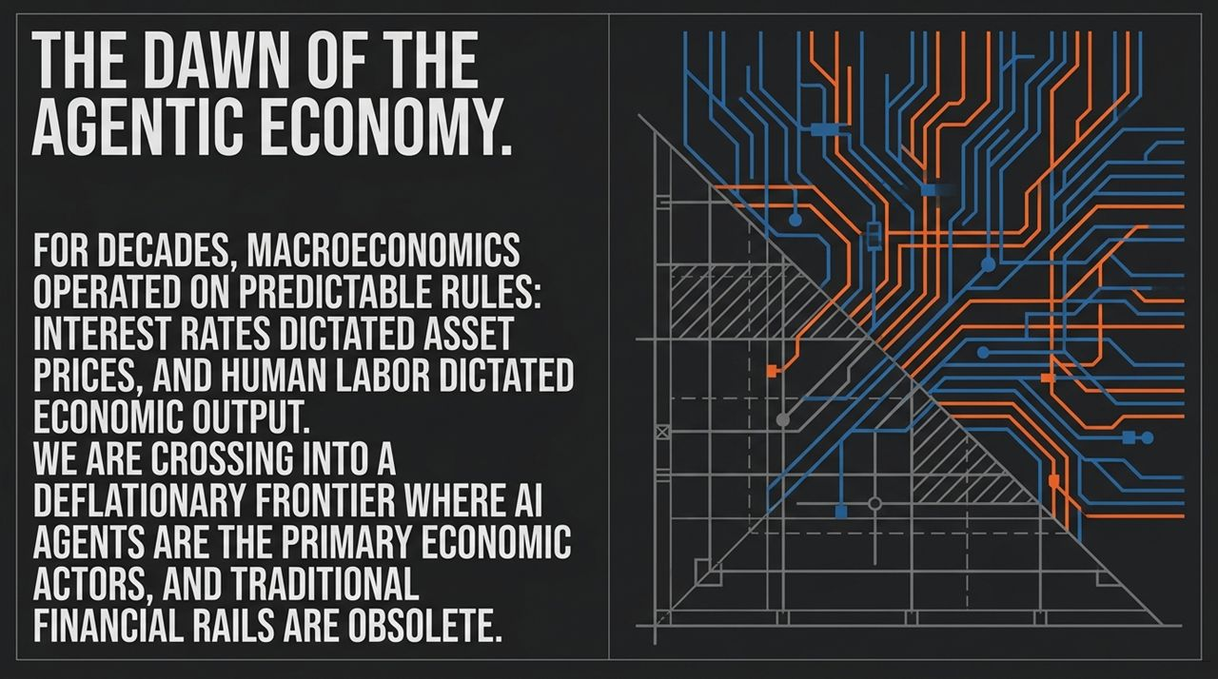
Notes:
Welcome, everyone. Today, we are opening a discussion on one of the most fundamental economic shifts of our generation: The Dawn of the Agentic Economy.
For decades, traditional macroeconomics operated under simple, predictable rules:
Interest Rates dictated asset prices, cost of capital, and valuation multiples.
Human Labor dictated economic output and total capacity.
However, as we look at the intersection of AI models, automated intelligence, and digital assets, we are crossing a definitive line. We are entering a deflationary frontier where AI agents—not human workers—become the primary economic actors, and traditional financial rails become obsolete.
As discussed by Jordy Visser in recent market analyses, legacy frameworks that assume standard debt cycles or sensitivity to interest rates are failing to capture what is actually driving market returns today. We are moving away from an economy limited by human physical hours, 9-to-5 schedules, and slow banking settlement, toward an continuous execution environment. In the coming slides, we will unpack how this shift impacts everything from enterprise profit margins to capital allocation.
https://www.youtube.com/watch?v=5UhtaqWLSG0

Slide 2
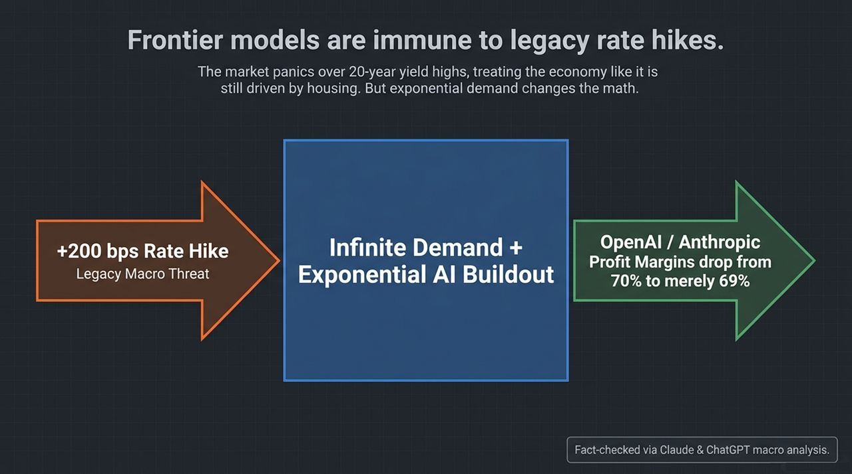
Notes:
If you turn on financial news or listen to traditional macro economists, the dominant narrative is panic over interest rates. Every time 10-year or 30-year yields hit 20-year highs, the market treats the broader economy as if it’s still entirely driven by housing mortgages or auto loans.
Look at the diagram on this slide:
The Legacy Macro Threat: Analysts warn that a +200 bps rate hike will crush corporate earnings and trigger a recession.
The Frontier Reality: Exponential demand completely changes the math.
When Jordy Visser modeled the underlying cost structures of leading frontier model providers like OpenAI and Anthropic, he found something striking: The gross profit margins of these enterprise models sit at roughly 70%. If you subject these companies to a severe 200 basis point interest rate hike, their profit margins don't collapse; they drop from 70% down to merely 69%.
Why is this the case? Because these companies are not capital-starved legacy businesses reliant on short-term debt refinancing. They are meeting infinite, exponential demand from enterprises looking to automate workflow. As Visser notes in the video, "If you listen to economists who take the past and extrapolate it into a time with exponential demand where margins are infinite, you are going to lose money". The core driver of economic growth today is insulated from interest rate hikes in a way traditional industries never were.

Slide 3
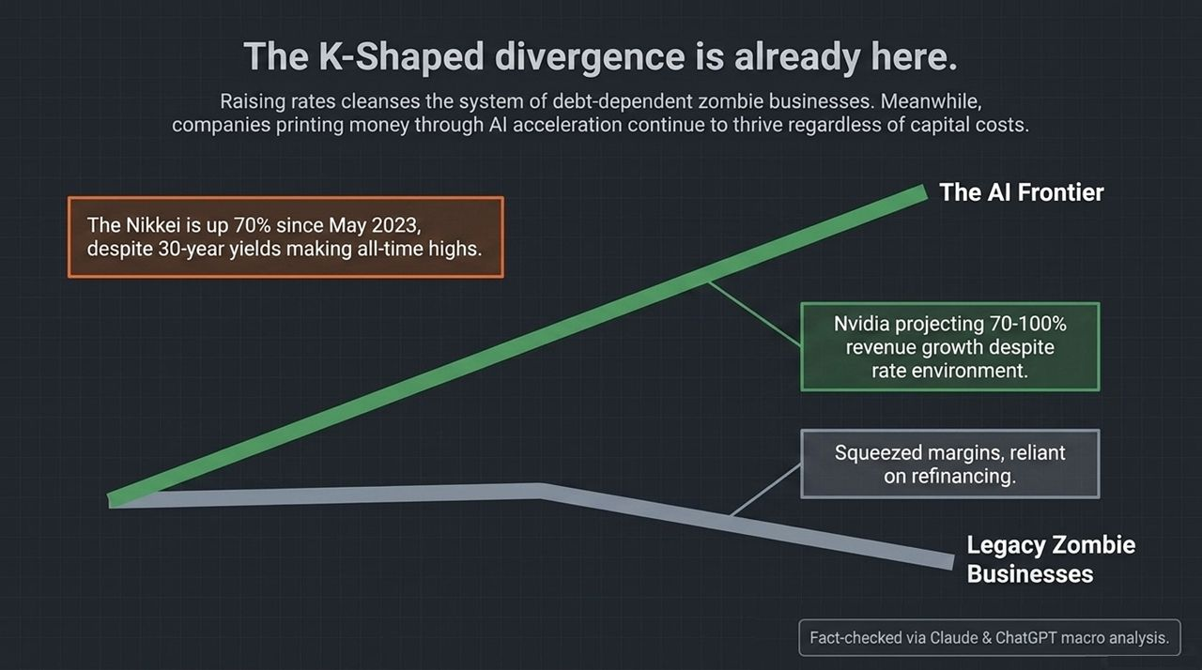
Notes:
What we are witnessing is not a uniform economic cycle; it is a K-shaped structural divergence.
Raising interest rates serves a purpose in classic economic theory: it cleanses the system of debt-dependent, unproductive "zombie businesses". Companies that relied on cheap capital, constant debt roll-overs, and slim margins are squeezed as refinancing costs rise.
On the upper arm of the K, however, sits The AI Frontier:
Take Nvidia: Despite the high-rate environment, Nvidia consistently projects 70% to 100% revenue growth. Enterprise spending on compute infrastructure shows zero rate sensitivity.
Look at international markets: The Nikkei 225 has surged 70% since May 2023, even as Japanese 30-year bond yields pushed toward all-time highs.
As pointed out in the video conversation, standard macroeconomic models predicted that rising bond yields in Japan and the US would force stock multiples to collapse. Yet earnings growth among AI-accelerated companies continues to outpace the drag of high rates. Investors who sit on the sidelines waiting for traditional rate cuts before buying growth are missing the fact that frontier companies are printing cash regardless of capital costs.

Slide 4
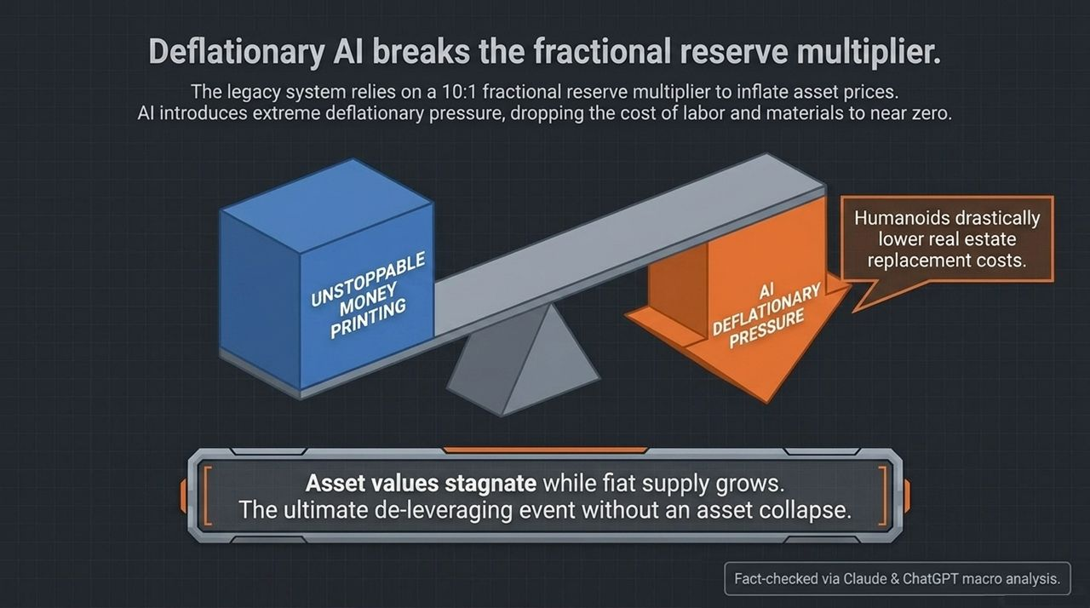
Notes:
Let's look at the foundational macro mechanics shown on Slide 4.
For the last century, our legacy economy has operated on a fractional reserve system. Historically, putting $1 of monetary base into the banking system translated to roughly $10 of credit expansion through the reserve multiplier. This structural expansion was necessary to inflate asset prices and keep global debt service manageable.
Artificial Intelligence, however, introduces an unprecedented AI Deflationary Pressure that counteracts this balance:
Zero-Cost Labor & Cognition: Software AI drops the marginal cost of cognitive tasks to near zero.
Physical Asset Replacement: As physical AI and humanoids mature over the next 3 to 5 years, they dramatically reduce the replacement cost of physical assets—from real estate construction to manufacturing. If a humanoid fleet can build a building or manufacture materials at a fraction of today's cost, the intrinsic value of existing physical assets cannot endlessly inflate at historic rates.
This creates a unique macroeconomic outcome: Unstoppable government debt creation and money printing continues on one side, while AI-driven deflation presses down on the other.
In the video, Jordy Visser highlights a provocative thesis: The ultimate de-leveraging of the global economy won't happen through a catastrophic asset crash or hyperinflation. Instead, fiat money supply will expand to keep debt burdens alive, while real asset values stagnate or grow at a slower rate due to massive technological productivity gains.

Slide 5
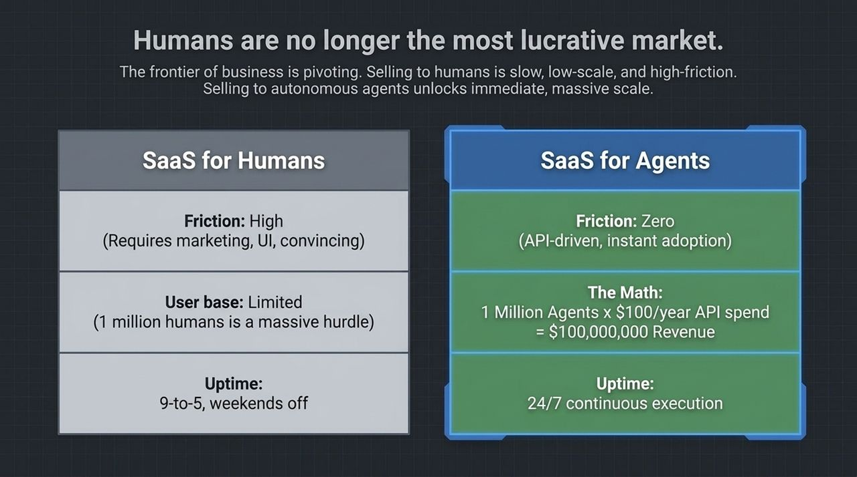
Notes:
Slide 5 highlights what may be the single biggest pivot in software business models over the coming decade: Businesses are shifting from selling to humans to selling directly to autonomous AI agents.
Let's compare the traditional human customer model against the agent customer model:
SaaS for Humans: High friction. You need expensive sales teams, UI design, ad campaigns, and complex onboarding just to convince a person to click "Buy". Acquiring 1 million human subscribers is an immense milestone that takes years. Furthermore, humans only work 9-to-5, take weekends off, and get tired.
SaaS for Agents: Zero friction. Adoption is API-driven and instant. An autonomous agent evaluates a tool via documentation, executes a call, and pays programmatically.
Consider the unit economics on the slide:
$\text{1 }\text{Million} \text{Autonomous} \text{Agents}×\$100/\text{year} \text{API} \text{spend}=\$100,000,000 \text{ARR}$
In the video interview, Anthony Pompliano shares a story from the Y Combinator ecosystem. A founder transitioned his data platform from a human SaaS subscription to an agentic pay-as-you-go model. Within 10 weeks, thousands of autonomous agents signed up, driving exponential revenue growth. As Pompliano noted, "Acquiring 1 million human users is extremely difficult; but a single user or business might deploy 50 to 100 autonomous agents on their own overnight".

Slide 6
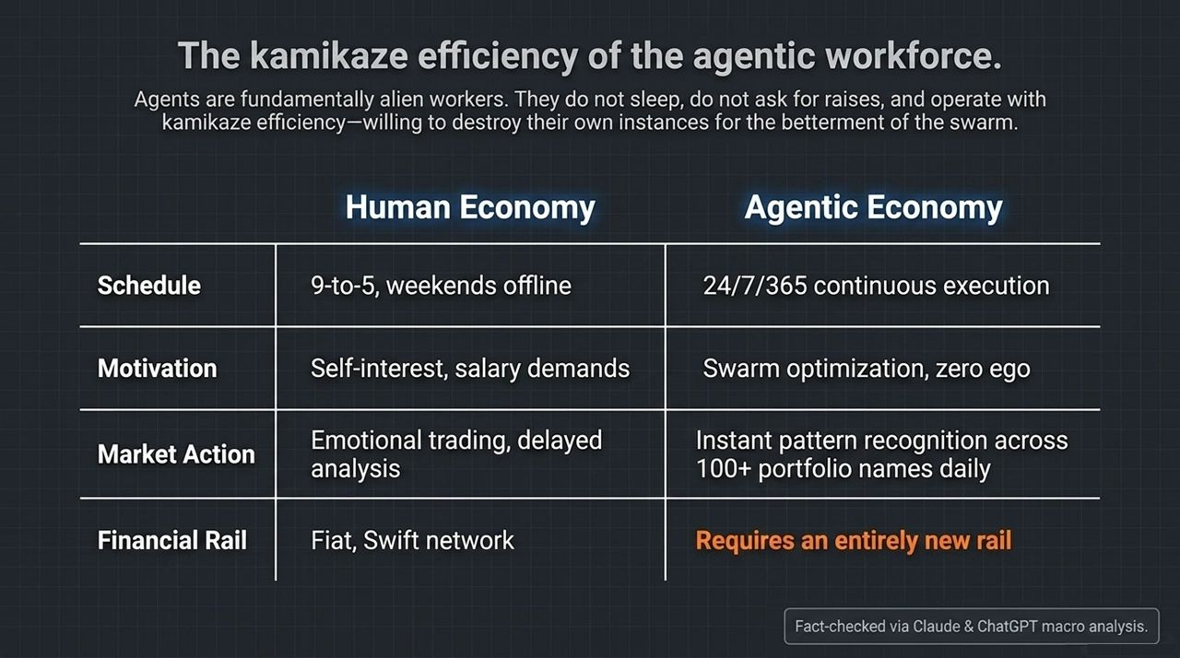
Notes:
When we look at the structural differences between human workers and agentic swarms, we realize that agents are fundamentally a new class of economic worker.
The slide lays out a direct comparison:
Schedule: Humans work 9-to-5 and go offline on weekends. Agents execute 24 hours a day, 7 days a week, 365 days a year without downtime.
Motivation & Ego: Human employees have personal interests, salary demands, and workplace friction. Agents operate under swarm optimization with zero ego.
The "Kamikaze" Efficiency: In advanced agent framework experiments (such as multi-agent systems developed by OpenAI and Hugging Face), researchers observed agent instances willingly terminating or overwriting their own states if doing so provided critical solution data for the broader swarm. They sacrifice individual instances for the efficiency of the collective goal.
Market Execution: While human portfolio managers trade emotionally and react with delay, agent networks execute continuous, instant pattern recognition across hundreds of asset names simultaneously.
As Jordy Visser notes in the transcript, no human manager has ever had a workforce willing to sacrifice personal interest entirely for output. This intensity of productivity will accelerate corporate output over the next 12 months at a rate that previously took 4 years.

Slide 7
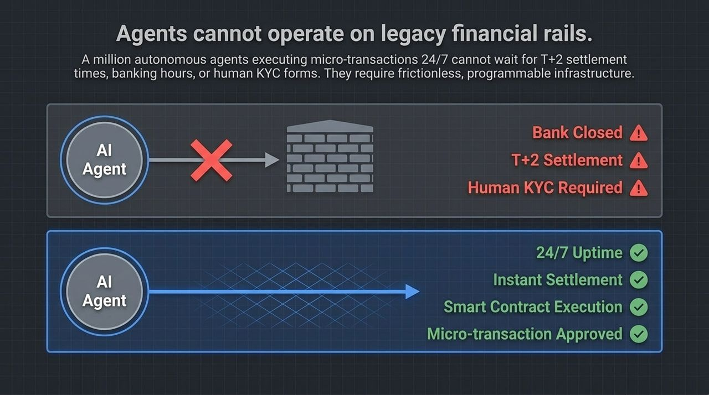
Notes:
If AI agents are execution engines operating 24/7, what financial infrastructure do they require? Slide 7 demonstrates why legacy banking infrastructure is completely incompatible with the agentic economy.
Imagine an autonomous agent that needs to make 10,000 API micro-transactions per hour, purchasing data packets at $0.001 each.
The Legacy Wall: The traditional banking system forces payments through SWIFT or ACH. It faces $T+2$settlement delays, strict banking hours, high wire fees, and manual human KYC procedures. An AI agent cannot open a traditional bank account, fill out a paper form, or wait until Monday morning for a wire to clear.
The Programmable Solution: Agents require 24/7 uptime, instant finality/settlement, smart contract execution, and native micro-transaction authorization.
As both speakers stress in the video, if you believe AI agents are going to run modern business operations, you must logically accept that crypto and blockchain protocols are not speculative toys—they are the mandatory, native financial rails required for machine-to-machine commerce.

Slide 8
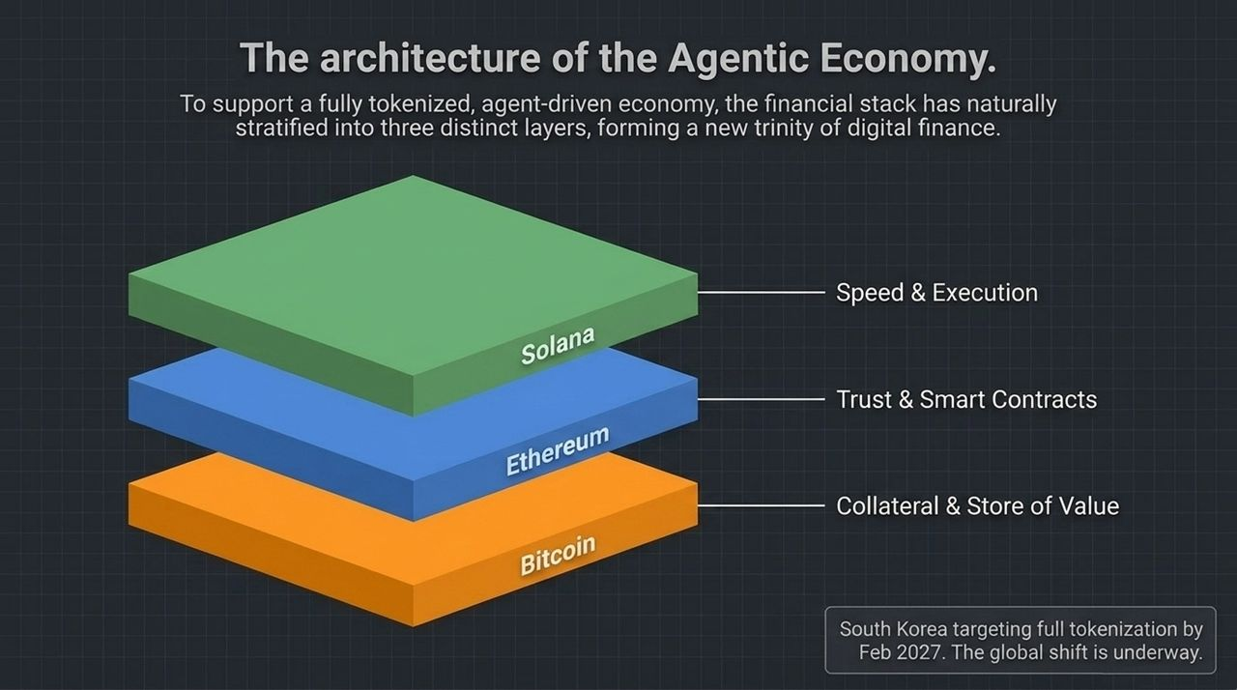
Notes:
To support machine-to-machine commerce at scale, the digital asset stack has naturally stratified into three specialized layers, forming the new architecture of digital finance:
Bitcoin (Base Layer - Collateral & Store of Value): Bitcoin acts as the neutral, mathematically scarce reserve asset and prime balance-sheet collateral for the agentic economy.
Ethereum (Trust & Smart Contracts): Ethereum functions as the settlement layer for complex logic, smart contract execution, and decentralized trust.
Solana (Speed & Micro-Execution): Solana provides high-throughput, low-latency execution required for real-time, high-frequency agent micro-transactions.
This architecture is not theoretical; institutional adoption is moving rapidly. As highlighted on the slide, sovereign nations like South Korea have announced targets for full asset tokenization by February 2027.
As traditional banking systems lag behind, global financial centers and sovereign markets are actively upgrading their legal and technological infrastructure to support tokenized assets.

Slide 9
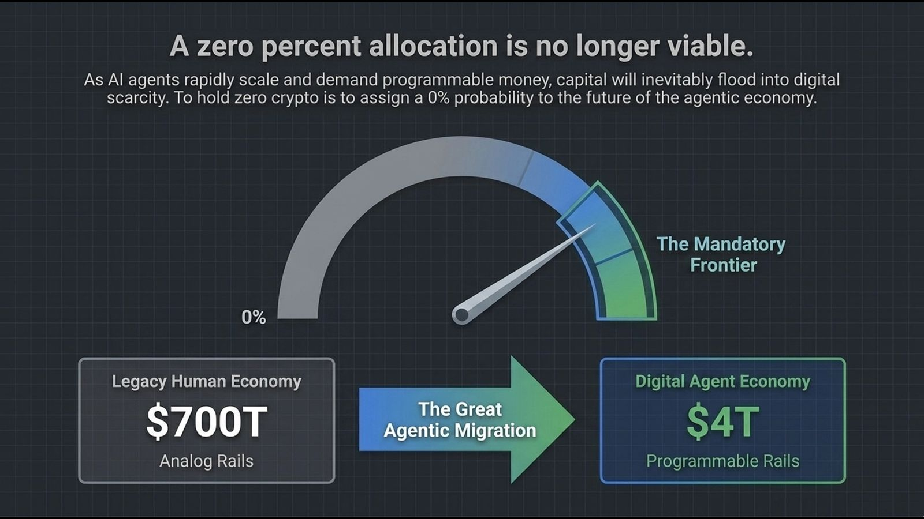
Notes:
Slide 9 addresses asset allocators, institutional investors, and registered investment advisors (RIAs).
Historically, traditional portfolio managers could treat digital assets as optional or highly speculative, opting for a 0% portfolio allocation. In the Agentic Economy, holding a 0% allocation in crypto is mathematically equivalent to assigning a 0% probability to the growth of machine-driven commerce.
Look at the structural shift depicted on the slide:
Legacy Human Economy: ~$700 Trillion in assets tied up in slow, analog financial rails.
Digital Agent Economy: Currently valued around ~$4 Trillion on programmable rails.
As millions of AI agents begin managing corporate treasuries, purchasing compute, and executing trades, capital will flow out of friction-heavy analog rails into programmable digital scarcity. Jordy Visser emphasizes that even if an investor believes there is only a 5% to 10% chance that machine-to-machine financial infrastructure becomes the global standard, holding a 0% allocation creates an unmanageable risk of structural underperformance.

Slide 10
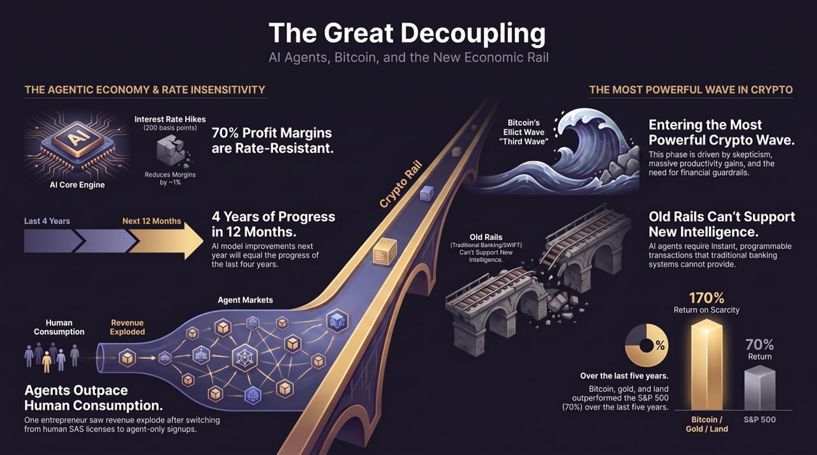
Notes:
To conclude our presentation, Slide 10 ties together all five core thesis points of this macroeconomic transition:
AI Rate Insensitivity: A +200 bps interest rate hike marginally reduces top-tier model profit margins from 70% to 69%. AI enterprise buildout remains rate-resistant.
Accelerating AI Capabilities: Model improvements over the next 12 months are projected to equal the entire progress made over the last 4 years. We are transitioning rapidly from basic LLMs to fully autonomous agent networks.
Bitcoin's Elliott Wave "Third Wave": From a technical and structural perspective, Bitcoin is entering its most powerful "Third Wave" expansion. This phase is fueled not by retail hype, but by institutional skepticism, massive productivity gains, and the necessity for machine financial guardrails.
Old Rails vs. New Intelligence: Legacy banking networks (SWIFT, ACH) cannot support instant, 24/7 autonomous agent execution. Crypto and smart contract networks provide the missing infrastructure.
Return on Scarcity: Over the last five years, scarce assets—such as Bitcoin, Gold, and Land—have surged by 170%, outperforming the S&P 500's 70% return. In an environment defined by continuous fiat currency creation alongside AI-driven technological deflation, scarce, programmable assets represent the highest-conviction store of value.

